Slide 1



Project PD–LEARN
Data Science and Machine Learning
in a Medical-Epidemiological Context
Christian Bracher

Slide 2
Background: Parkinson's Disease
Debilitating, incurable chronic disease; common
Causes and mechanism of PD not well understood
Parkinson Progression Marker Initiative
$60M world-wide, multimodal clinical study
~1,000 subjects, with ~200 assessments per subject
Data science & machine learning approach!

Slide 3

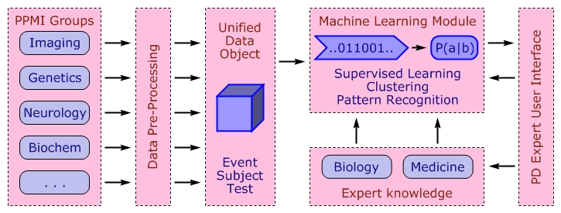
Machine Learning Support for PPMI
“Backend” processes, integrates study data

Slide 4
Machine Learning Support for PPMI
“Core” hosts statistics & ML capabilities

Slide 5
Machine Learning Support for PPMI
“Frontend”: User-friendly interface for PD experts

Slide 6
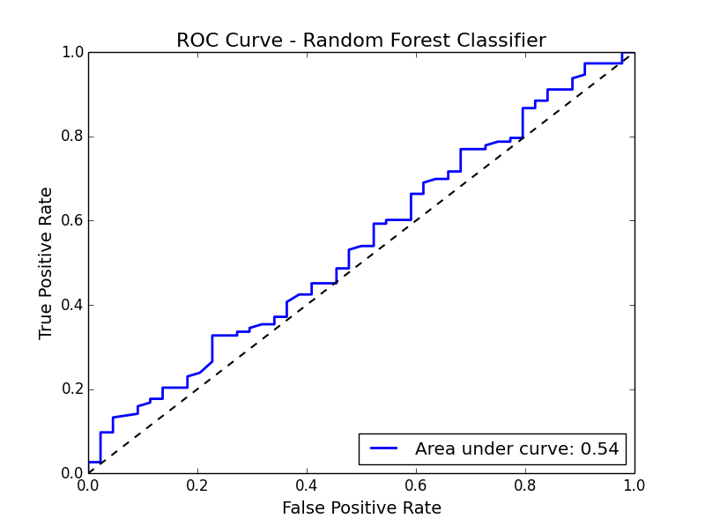
Insight: CSF Proteins Do Not Predict PD

Slide 7
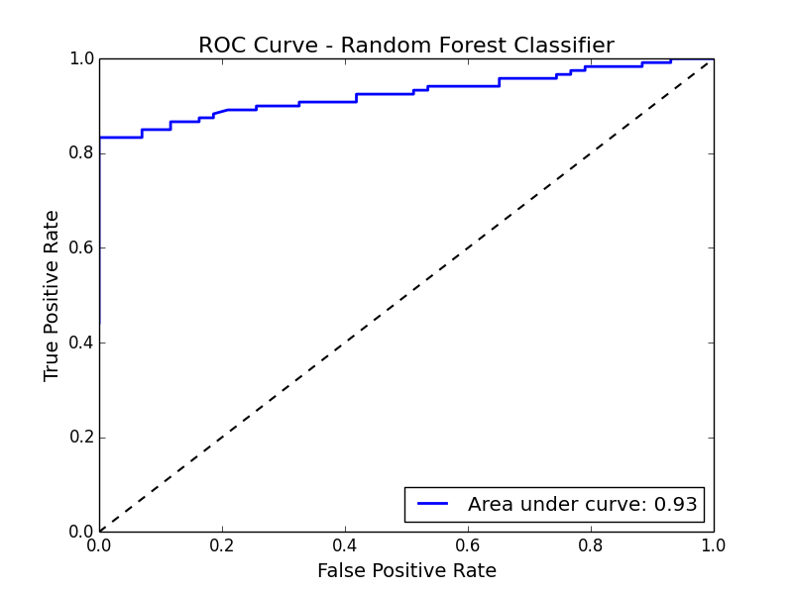
Insight: Sensitivity of SPECT Imaging
~15% of PD patients “fail” test!

Slide 8
Summary & Outlook
Machine learning framework for PPMI study data
Gathering first insights on Parkinson's Disease
Coding challenges: Add features, build interface
Research: Identify clusters, progression markers
'Best practices' for PD diagnosis

Slide 9
THANK YOU!
Acknowledgments:
Mijail Gomez and the folks at Zipfian Academy
Eric Liu, Paul Duan & everyone @ Bayes Impact
Ken Kubota from the Michael J. Fox Foundation
The Parkinson's Progression Marker Initiative

